Slide 1
Banks Marketing Campaign Analysis with Machine Learning
Final Project

Slide 2




Our team
Monika Pangestu
Zaki Fajri
Industrial Engineering
Geophysical Engineering
Assc. Technical Consultant
(BI: Tableau)
Underground Geotech Engineer

Slide 3
Outline
01
Business Background
03
Data Processing & Modelling
02
Data Understanding & Exploration
04
Conclusion & Recommendation

Slide 4
01
Business Background

Slide 5
Business Context
Because of economic globalization, banks and financial services have seen major changes in terms of technology, strategy, and customer service. Financial Industry is forced to adopt emerging technologies on how to leverage technology to better serve their customers. One of the practice is telemarketing.
Portugal Bank is one of the banks that utilize telemarketing approach to offer the clients the opportunity to place a term deposit. However, there has been a decrease in deposit rate, and we would like to know what measures to take.
Zeta Squad as the Bank’s Data Scientist team has an important task to find out the root cause and provide insight with appropriate recommendations for stakeholder (Bank’s Marketing Department) in order to increase the deposit rate.
Deposit Form

Slide 6
Business Problems
Low deposit subscription rate
Ineffective telemarketing efforts
Potential customer loss
The current deposit rate is only 11%
waste time, human resources, and operational expenses
Unable to reach more potential customers as resources have been wasted
Customers are irritated by spam calls

Slide 7
Objectives
Predict the Customer’s Tendency
Understand the Customer’s Preference
Create a machine learning and evaluate the performance to predict customers’ decision
Find out which factors that can influence a customers decision

Slide 8
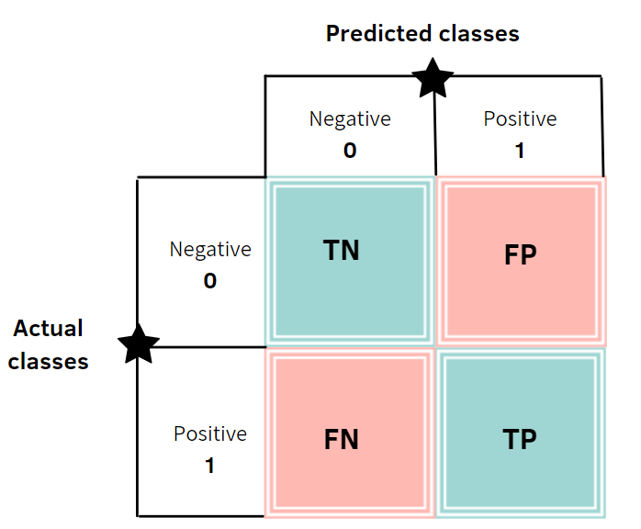
Analytic Approach
In this analysis we want to see the tendency of customers to subscribe a term deposit by doing a machine learning analysis and evaluate the model performance through ROC-AUC Score.
True Negative (TN) | Actual(0) & Predict(0):
The model predicts that the consumer will not make a deposit, and the customer does not.
True Positive (TP) | Actual(1) & Predict(1):
The model predicts that the consumer will make a deposit, and the customer does.
False Negative (FN) | Actual(1) & Predict(0):
The model predicts that the customer will not make a deposit, however the customer does make a deposit.
False Positive (FP) | Actual(0) & Predict(1):
The model predicts a deposit even if the consumer does not make a deposit.
Therefore, we try to suppress the False Positive (FP) Score of the Confusion Matrix to improve the telemarketing efforts.

Slide 9
02
Data Understanding & Exploration

Slide 10
Data Description
The data is related with direct marketing campaigns of a Portugal banking institution.
Data Set Characteristics: Multivariate
Attribute Characteristics: Real
Associated Tasks: Classification
Number of Instances: 41188
Number of Attributes: 21
Missing Values: coded as unknown
Area: Business
Source : https://www.kaggle.com/datasets/volodymyrgavrysh/bank-marketing-campaigns-dataset
(which the data modified from [Moro et al., 2014] S. Moro, P. Cortez and P. Rita. A Data-Driven Approach to Predict the Success of Bank Telemarketing. Decision Support Systems, Elsevier, 62:22-31, June 2014)

Slide 11
Feature Description
Bank Clients Data
Social & Economic Attributes
Feature | Data Type | Description
Age | Numerical | Customers age
Job | Categorical | Type of job
Marital | Categorical | Marital status
Education | Categorical | Education level
Default | Categorical | Has credit in default?
Housing | Categorical | Has housing loan?
Loan | Categorical | Has personal loan?
Feature | Data Type | Description
emp.var.rate | Numerical | employment variation rate - quarterly indicator
cons.price.idx | Numerical | consumer price index - monthly indicator
cons.conf.idx | Numerical | consumer confidence index - monthly indicator
euribor3m | Numerical | euribor 3 month rate - daily indicator
nr.employed | Numerical | number of employees - quarterly indicator
Current Campaign Record
Campaign Tracing Record
Feature | Data Type | Description
Contact | Categorical | Contact communication type
month | Categorical | Last contact month of year
Day of week | Categorical | Last contact day of the week
Duration | Numerical | Last contact duration (seconds)
Feature | Data Type | Description
campaign | Numerical | number of contacts performed during this campaign
pdays | Numerical | number of days that passed by after the client was last contacted from a previous campaign
previous | Numerical | number of contacts performed before this campaign and for this client
poutcome | Categorical | outcome of the previous marketing campaign

Slide 12
Data Conditioning
Change Unknown to NaN
Since missing values are coded as unknown, therefore, all unknown data will be replace with NaN.
Drop the Missing Value
There are 6 variables that have missing values:
job (0.8%), marital (0.19%), education (4.2%), default (20.87%), housing (2.4%), loan (2.4%)
All missing data from those variables will be dropped except for default.
Initial dataset : 41188
Filtered dataset : 38245
Cleaned dataset (%) : 92.85
With all the missing value removed, then we are left with 92% of data samples for further analysis.

Slide 13
Data Conditioning
Adjust the Categorical Data
Grouping the Age Class
simplify the age structure based Portugal Age Structure with several class as follows :
Age Class | Age Range
Children | 0 - 14 years
Early Working Age | 15 - 24 years
Prime Working Age | 25 - 54 years
Mature Working Age | 55 - 64 years
Elderly | 65 years and over

Slide 14
Data Conditioning
Adjust the Job Class
Merging unemployed & retired as non workers since those classes are no longer in workforce. So, from 11 job category we will have only 10 category.
Job category : Housemaid, services, admin, technician, blue-collar, non-worker, management, self-employed, entrepreneur, student
Adjust the Education Class
The education variable adjusted based on Portugal Educational System Chart, where as:
Education Category | Description
Basic Ed. | Basic.4y, basic.6y, basic.9y, illiterate*
Secondary Ed. | High.school, professional.course
Higher Ed. | university.degree
*since illiterate data samples are very low then we merge it with basic education group

Slide 15
Data Conditioning
Adjust the Campaign Class
Grouping the campaign variable into 5 classes.
Campaign class : [1-6], [7-12], [13-18], [19-24], [25+]
Create new variable class_response
Make new variable call_response based on duration variable.
Call_response : whether or not a customer responds to a call (yes/no).
Yes : any duration above 36 seconds, those customers are assumed willing to listen
to the campaign.
No : any duration below 36 seconds, those customers are assumed as non responsive
customer where they might pickup a call but refuse to receive any information
from the telemarketing.

Slide 16
Data Conditioning
Grouping the Previous Days Class
Classify the days in the pdays into weekly categories.
Weekly Categories | Number of Days
last_week | 0 - 7 days
last_2weeks | 8 - 14 days
last_3weeks | 15 - 21 days
last_4weeks | 22 - 28 days
not_contacted | 999 days*
*As per data documentation, 999 days means client was not previously contacted

Slide 17
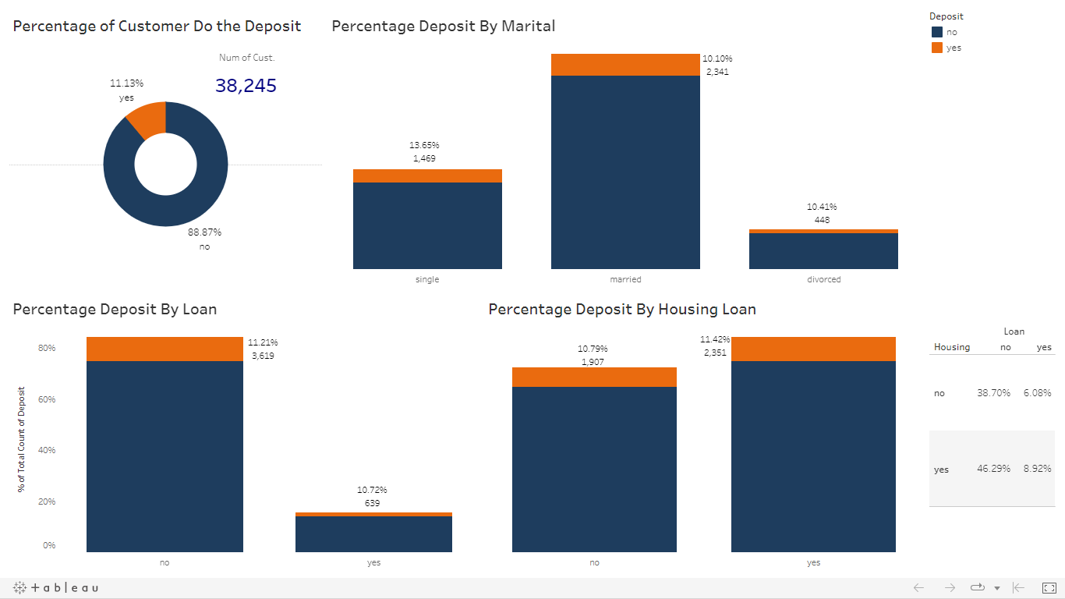
Exploratory Data Analysis (EDA)
Campaign Period | Total Customers | Deposit Rate (%)
Previous Campaign | 5,179 | 25.8
Current Campaign | 38,245 | 11.13
The percentage of people who does the deposit (11%) are lower than the people who doesn’t (89%)
Single & divorce category have more percentage of deposit customer than the married category (single deposit : 13.65%, married deposit : 10.10%, divorced deposit : 10.41%). It’s probably due to customer with single status has less living expenses compared to the other two categories.
Most of the customer have no personal loans & housing Loan, there are about 46% of total customers
Notes : Please always do the fullscreen mode to have a proper layout in Tableau after click the link
Notes:
Tableau Public : https://public.tableau.com/app/profile/monika.pangestu/viz/Zeta-EDAPresentationVer_/Dashboard1?publish=yes

Slide 18
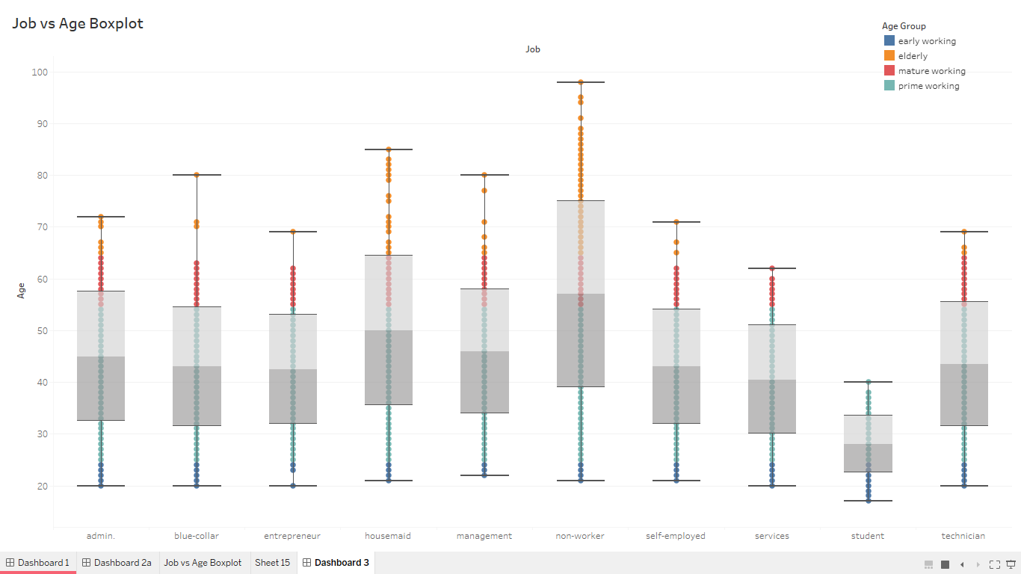
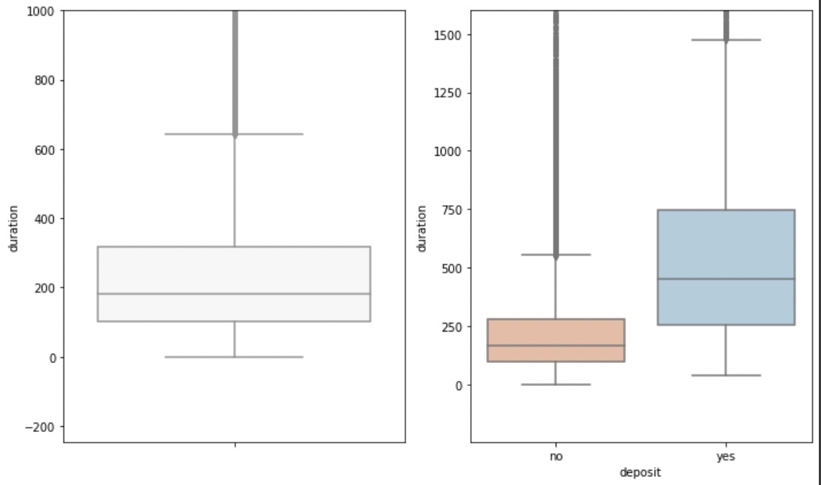
Exploratory Data Analysis (EDA)
Call Durations
The job vs age boxplot displays that despite of the most customers are in prime working age, the median of all job classes are generally above 40yo (except the student class). It means that the bank targeted more on experience workers instead of entry level workers. It’s probably that telemarketer perceives experience workers has more money and tend to subscribe to deposits.
Based on call durations boxplot, it can be seen where customers who are interested in opening a deposit spend time 50% longer (median > 6mins) on the phone compared to those who are not interested (median < 4mins).

Slide 19
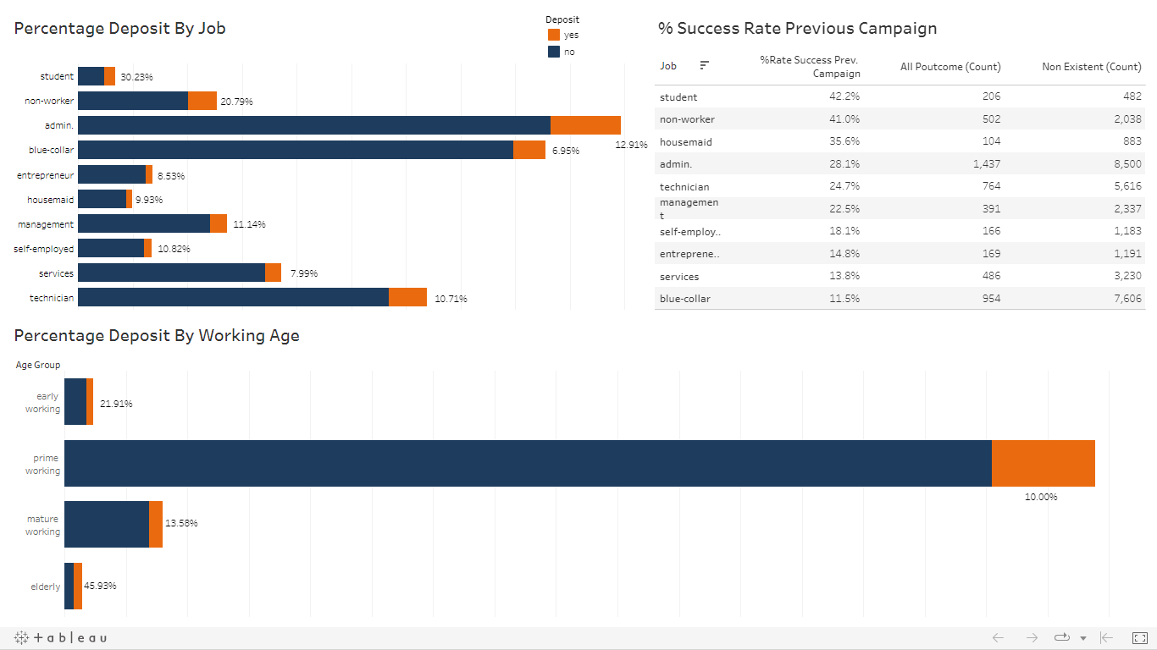
Exploratory Data Analysis (EDA)
From the charts and table above, it can be seen that the top 3 deposit rate based on job class are student, non-worker (mostly retiree) and admin. It is also supported by the age group variable where early working age and elderly have the highest deposit rate, 21.9% and 45.9% respectively.
The previous campaign rate also illustrate the resemblance output with the current campaign. From the table we can see that telemarketer did not continue targeting the highest deposit rate from previous campaign but instead reaching admin, blue-collar and technician where they have low deposit rate. We can infer that telemarketer has false perception on customer’s market target.
Notes:
Tableau Public : https://public.tableau.com/app/profile/monika.pangestu/viz/Zeta-EDAPresentationVer_/Dashboard1a?publish=yes

Slide 20
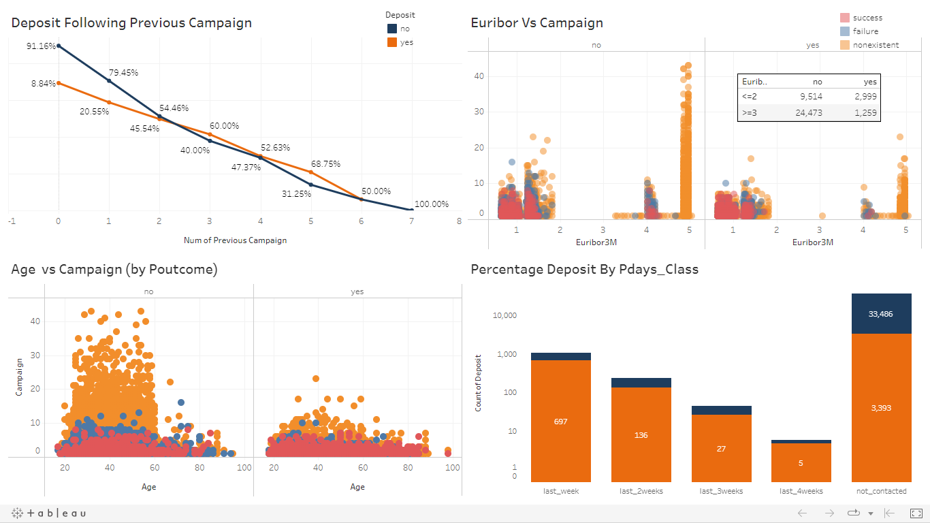
Exploratory Data Analysis (EDA)
From previous campaign graph, it displays that the deposit rate significantly dropped when telemarketer contacted customer more than 6 times. It’s also in line with age vs campaign chart where most of contacted customers are new customer and classified as prime working age. However, most of them reject the offer when they’re bombarded with phone calls more than 6 times. It’s possible that they feel irritated with the spam calls.
On the other hand, when telemarketer interact with customer within a reasonable follow up period (1 week period), the deposit rate becomes higher.
From euribor vs campaign chart, we can see that telemarketer contacted new customers when the interest rate > 3%. Meanwhile they mainly contacted failure and success customer on previous campaign when the interest rate is low < 2%. Nevertheless, deposit rate may rises if they reached them when the interest rate is high.
Notes : Please always do the fullscreen mode to have a proper layout in Tableau after click the link
Notes:
Tableau Public : https://public.tableau.com/app/profile/monika.pangestu/viz/Zeta-EDAPresentationVer_/Dashboard2a

Slide 21
03
Data Processing & Modelling

Slide 22
Defining Relevant Data Discretization
Some of the following characteristics will be dropped as they have little bearing on the effectiveness of the marketing effort:
default | It has too many unknown data (20% of all data) to be dropped. Meanwhile, the data of this variable are imbalance where 3 data as non-default and the rest are default. Instead of removing samples, this variable will be excluded for further processing.
contact | The contact method (cellular, telephone, and unknown) provides no useful information.
duration | It will be excluded from modeling process since we are intending to predict the potential customer prior the calling.
New variable are created (campaign_reps, pdays_class & age_group as in categorical variable) to replace campaign, pdays, and age which was numerical variable and will be included in a new subset.

Slide 23
Data Processing Workflow
Modeling
Baseline Model Benchmarking
Baseline Model Selection
Imbalance Method Benchmarking
Imbalance Method Selection
Clean Dataset
Preprocessing
Model Evaluation
Features Encoding
Data Train Test Split
Hyperparameter Tuning
Feature Importance
Feature Selection
Final Model Output

Slide 24
Preprocessing
80%
20%
Data are encoded through transformer and the encoding methods applied in this dataset are:
One Hot Encoder for [age_group, job, marital, education, housing, loan,
campaign_reps, pdays_class, poutcome]
Binary Encoder for [month, day]
Then data are split between train set and test set as follows:
Train
Test

Slide 25
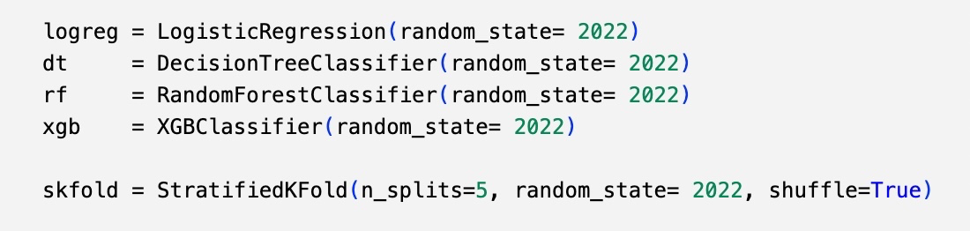
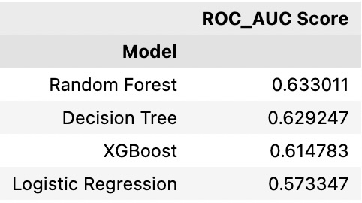
Modeling - Benchmark
Baseline model we used in this dataset are:
Then the cross validation method that we implement as follows:
Baseline model’s score:

Slide 26
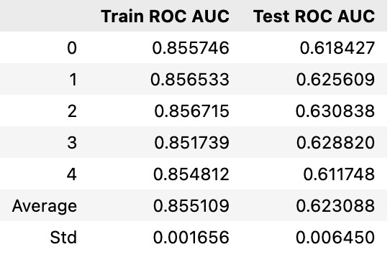
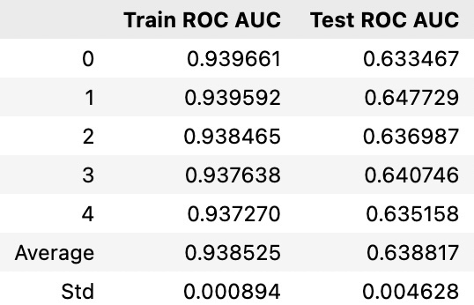
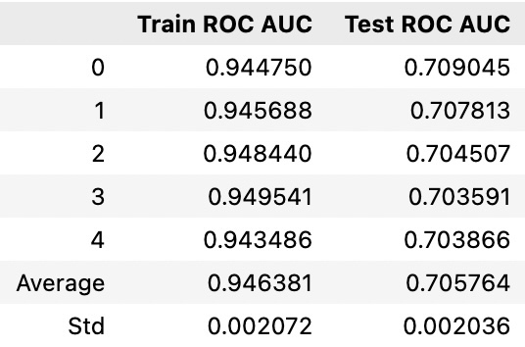
Modeling - Imbalance
Since the target (deposit) consists of yes (11%) and no (88%), it indicates imbalance data and will affects on model's prediction. Therefore, imbalance treatment will be applied. This project will implement Random Over Sampling (ROS) and Random Under Sampling (RUS) for imbalance treatment based on Random Forest model as it has the highest benchmark score.
No Treatment
Random Over Sampling
Random Under Sampling
No Treatment ROC-AUC Score: 0.615
ROS ROC-AUC Score: 0.65
RUS ROC-AUC Score: 0.711

Slide 27
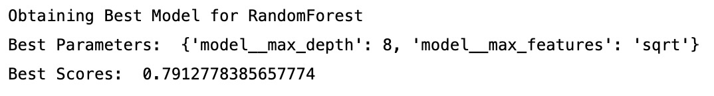
Model Evaluation
Hyperparameter Tuning
K-Fold | Baseline Model | Fine Tuned Model
0 | 0.746328 | 0.786441
1 | 0.762797 | 0.801643
2 | 0.734492 | 0.792255
3 | 0.736558 | 0.781981
4 | 0.765769 | 0.794070
Mean | 0.749189 | 0.791278
Std | 0.013 | 0.007
Models | ROC-AUC Score
Baseline Model | 0.71
Hyperparam Model | 0.74

Slide 28
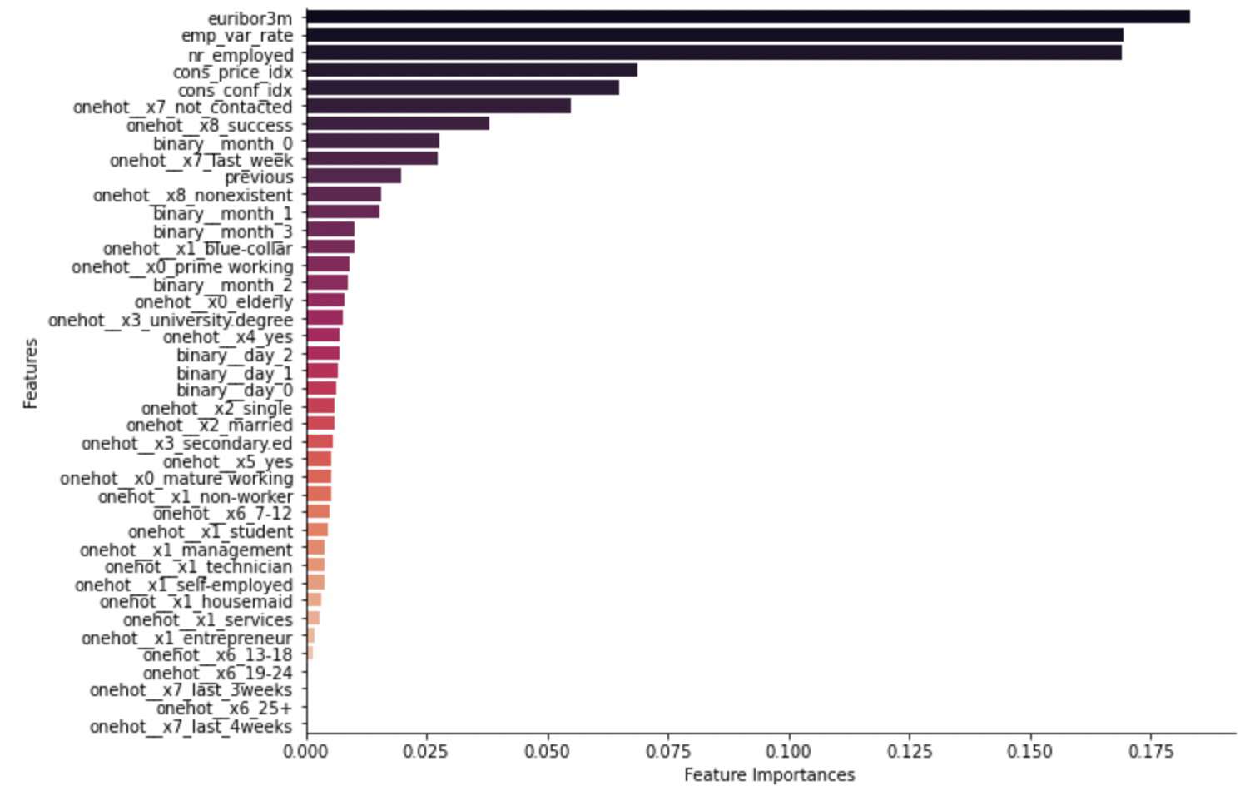
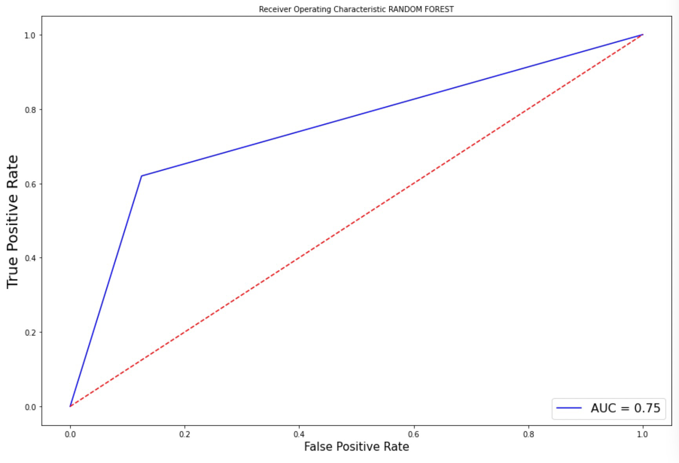
Model Evaluation
Feature Importance & Feature Selection
The graph displays the importance of a variable/feature. It can be seen that euroibor3m is affecting model the most followed by emp_var_rate and nr_employed.
Meanwhile, campaign_reps and pdays_class has the lowest importance. Then we will re-select the features (removing campaign_reps and pdays_class) and the model’s performance is slightly improved.

Slide 29
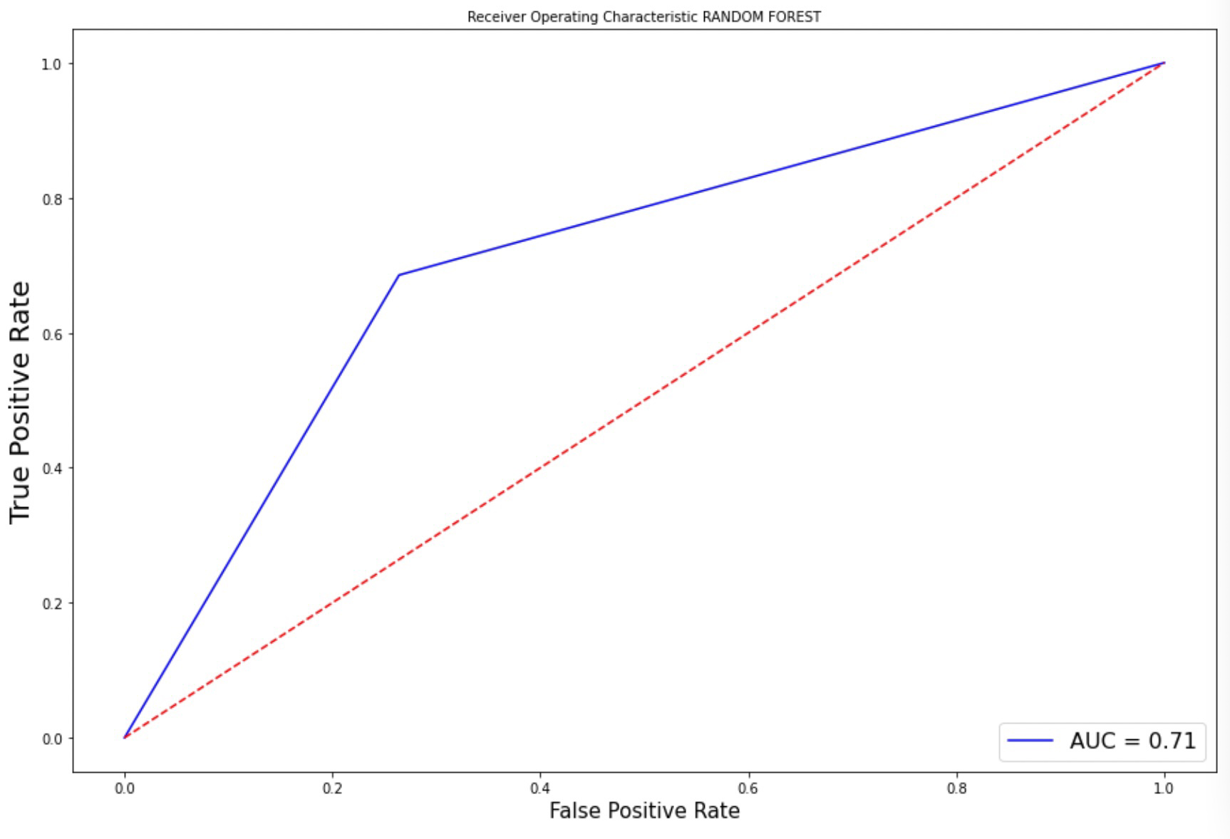
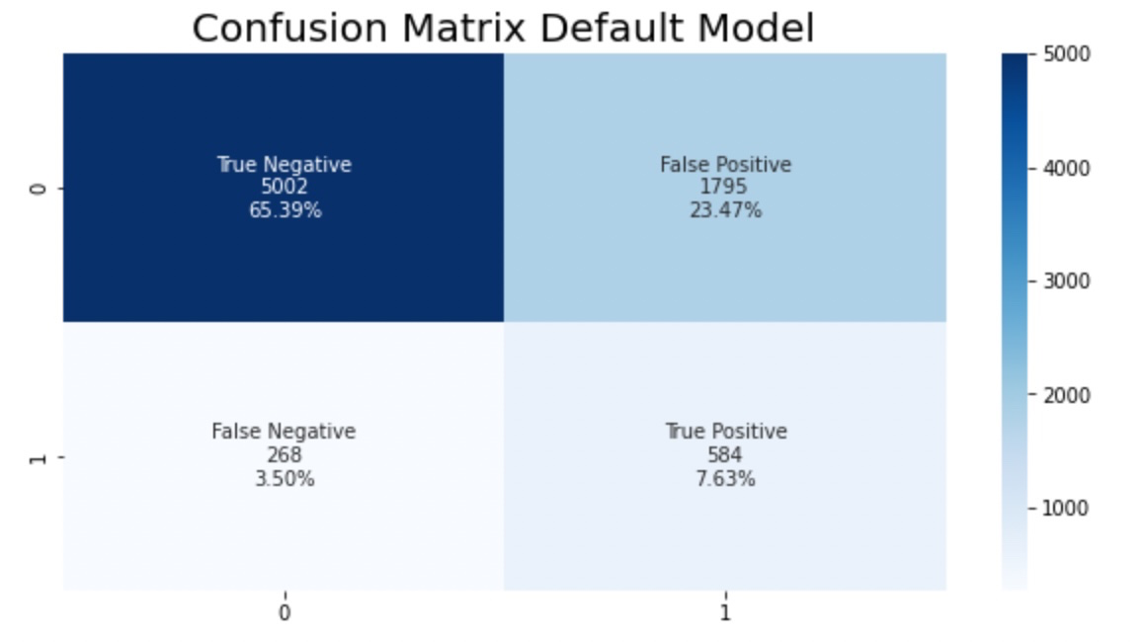
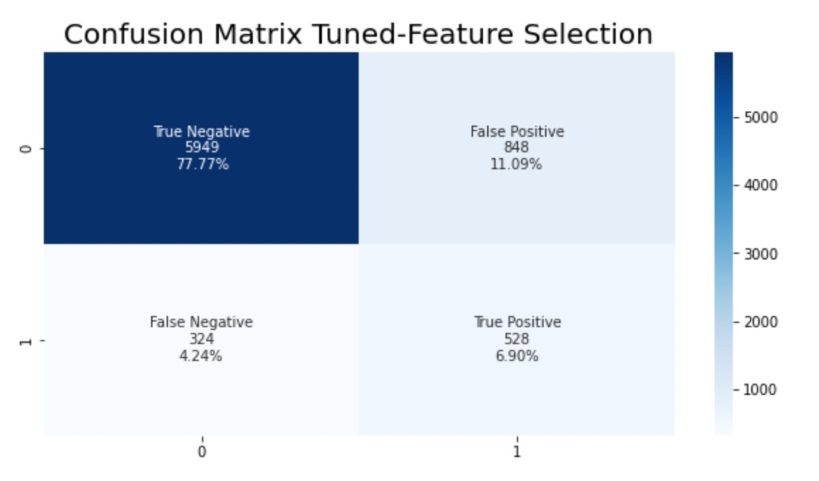
Final Output
After tuning the model and implement feature selection, the model’s performance increase from 0.71 to 0.75.
Furthermore, we were able to reduce the false positive rate by half, from 23.5 percent on the default model to 11 percent on final model.
Default Model’s Score
Fine-Tuned Model’s Score

Slide 30
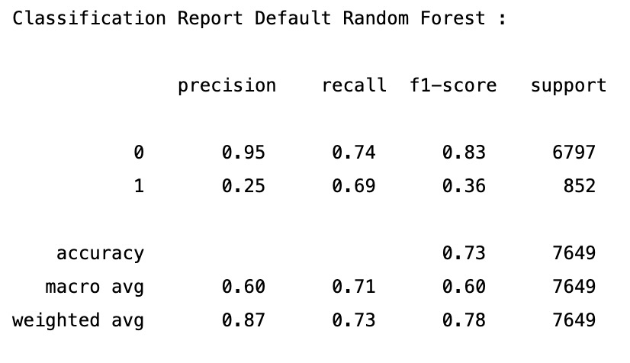
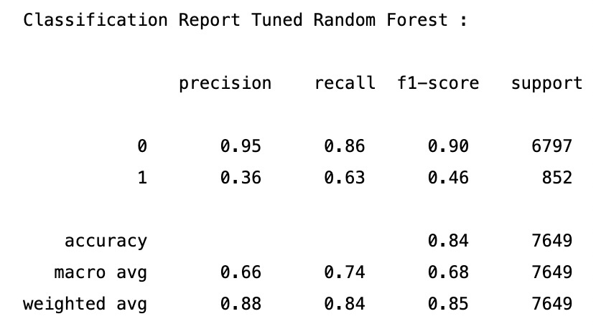
Final Output

Slide 31
04
Conclusions & Recommendations

Slide 32
Conclusions
Customer Preferences
Base on marital status customer with single status have higher deposit rate since they have less living expenses compared to the other categories (married & divorce)
Telemarketer perceives experience workers (age median >40yo) has more money and tend to subscribe to deposits. However the highest deposit rate is on by student & non-workers (early working & elderly). It can inferred that telemarketer has false perception on customer’s market target.
Most of the customers feel irritated with the spam calls when they’re bombarded with phone calls more than 6 times.
Deposit rate may rises if telemarketer reached not only focus on new customers but also to success customers on previous campaign when the interest rate is high.

Slide 33
Conclusions
Customer Prediction
Our model has fair performance as we obtain 0.75 of ROC-AUC score
We want to suppress the prediction on False Positive (FP), as FP value means the model predict the customer will subscribe to a deposit but in actual they don't. Having this condition : 1. The telemarketer will waste more resource on non-prospective customers. 2. We do lost the profit and operational cost.
As the output, our model can reduce the FP class from 1795 (23.5% of total) customers to 848 (11 % of total) customers. This mean we can reduce up to +50% of the big loss operational business cost and efficiency can be reach.

Slide 34
Business Impact
Costing & Revenue Simulation
Total Customer = 2,000 persons
Marketing cost = $ 1 /persons
Revenue = $ 10 /persons
FP Simulation (Default)
Total FP = 470 persons (23.5% of total customers)
Total marketing Cost : $ 1* 2,000 = $ 2,000
Total Revenue = $ 10 * (2,000-470) = $ 15,300
Total Profit = $ 15,300 - $ 2,000 = $ 13,300
FP Simulation (Final Model)
Total FP = 220 persons (11 % of total customers)
Total marketing Cost : $ 1* 2,000 = $ 2,000
Total Revenue = $ 10 * (2,000-220) = $ 17,800
Total Profit = $ 17,800 - $ 2,000 = $15,800
Given the simulation, we can see that there are big efficiency & effectiveness if we suppressed the FP as the profit increase approximately $ 2,500 (18.8%)

Slide 35
Recommendations
Stakeholder can be more focused on targeting customer that were loan-free Many term deposit subscribers were loan-free. There are also those who have a loan but have not subscribed to the deposit, as well as those who do not have a loan but have not signed to the deposit. The primary reason for this is balance. Those with a sufficient balance amount are more likely to subscribe to a term deposit.
Stakeholder can avoided contacts the customers more than 6x Based on our findings, the majority of customers that subscribe to deposit have had contacted less than six time. Hence, contacting someone more than six times should be avoided. It’s possible if telemarketer contacting the customer more than 6x, the more customer feel irritated.
Stakeholder can focused more on targeting customer with strong educational background There are many subscribers with a strong educational background. We feel that an higher educational person with some understanding of investing will take some extra time to understand the offer presented.

Slide 36
Recommendations
Stakeholder can be more focused on targeting customer that have job in category : students, admin or non-workers (in conjunction with other variables) Targeting students, non-workers, or admin will result in more success. Based on data, those with employment professions such as blue-collar, entrepreneur, services and so on had a very low favorable reaction. We better avoided targeting those category, or at the very least, other aspects such as balance, debt, and education should be considered before addressing them. Overall, this component should be used in conjunction with education.
Stakeholder can be more focused in contacting customer that success in previous campaign when interest rate high Given the data, we can see that telemarketer contacted more non-existent customer when the interest rate is high. It’s possible that low deposit rate cause by the telemarketer contacted success and failure customers on previous campaign when the interest rate is low.
Stakeholder can add more features to be analyze We can also adding another related features such as saving balances, detail of periode year, amount of loan (personal & housing), deposit interest rate, terms of deposit (lock periode), opening deposit balance, etc.

Slide 37
Thank
you !

